Slide 1


Lean Canvas Model
Founder Academy Guide

Slide 2






Best Practices for Using the Lean Canvas Model
As an early-stage entrepreneur, the Lean Canvas model can be a valuable tool for helping you to plan and develop your business idea. Here are some best practices to consider when filling out the Lean Canvas model:
Start with a problem
Be specific
Test your assumptions
The Lean Canvas is designed to help you solve a specific problem so begin by defining what need you are addressing.
For your customer segments and value proposition, be clear and specific about what makes your approach unique.
Use the Lean Canvas as a framework for evaluating your hypotheses about your business idea and strategies.
Keep it simple
Iterate and adapt
Be realistic
The Lean Canvas is a simplified version of a business plan so keep it concise to help focus on the most critical aspects.
Continue to use the Lean Canvas as your business model evolves based on feedback from customers and investors.
Identify the resources you need to test your business ideas and be realistic about the time and money available.

Slide 3
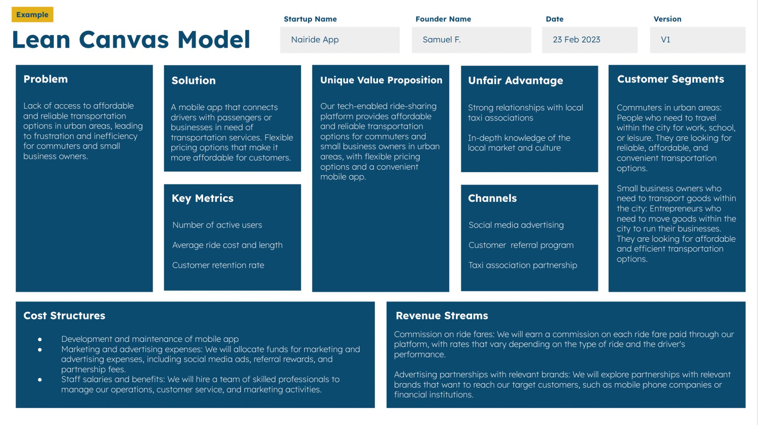
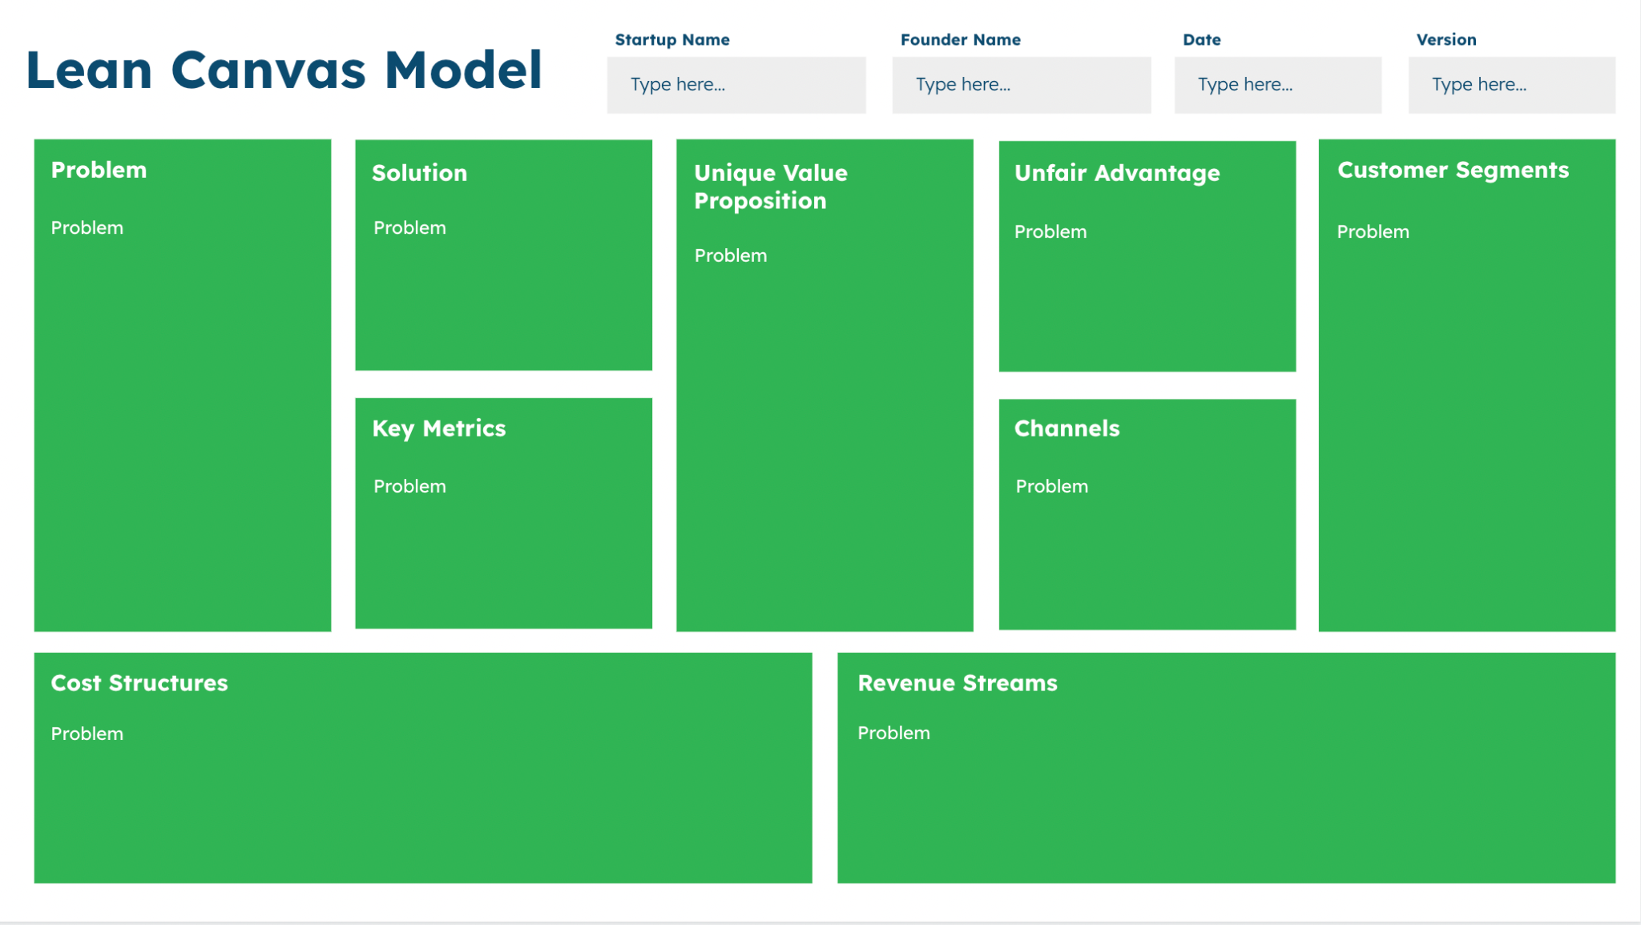
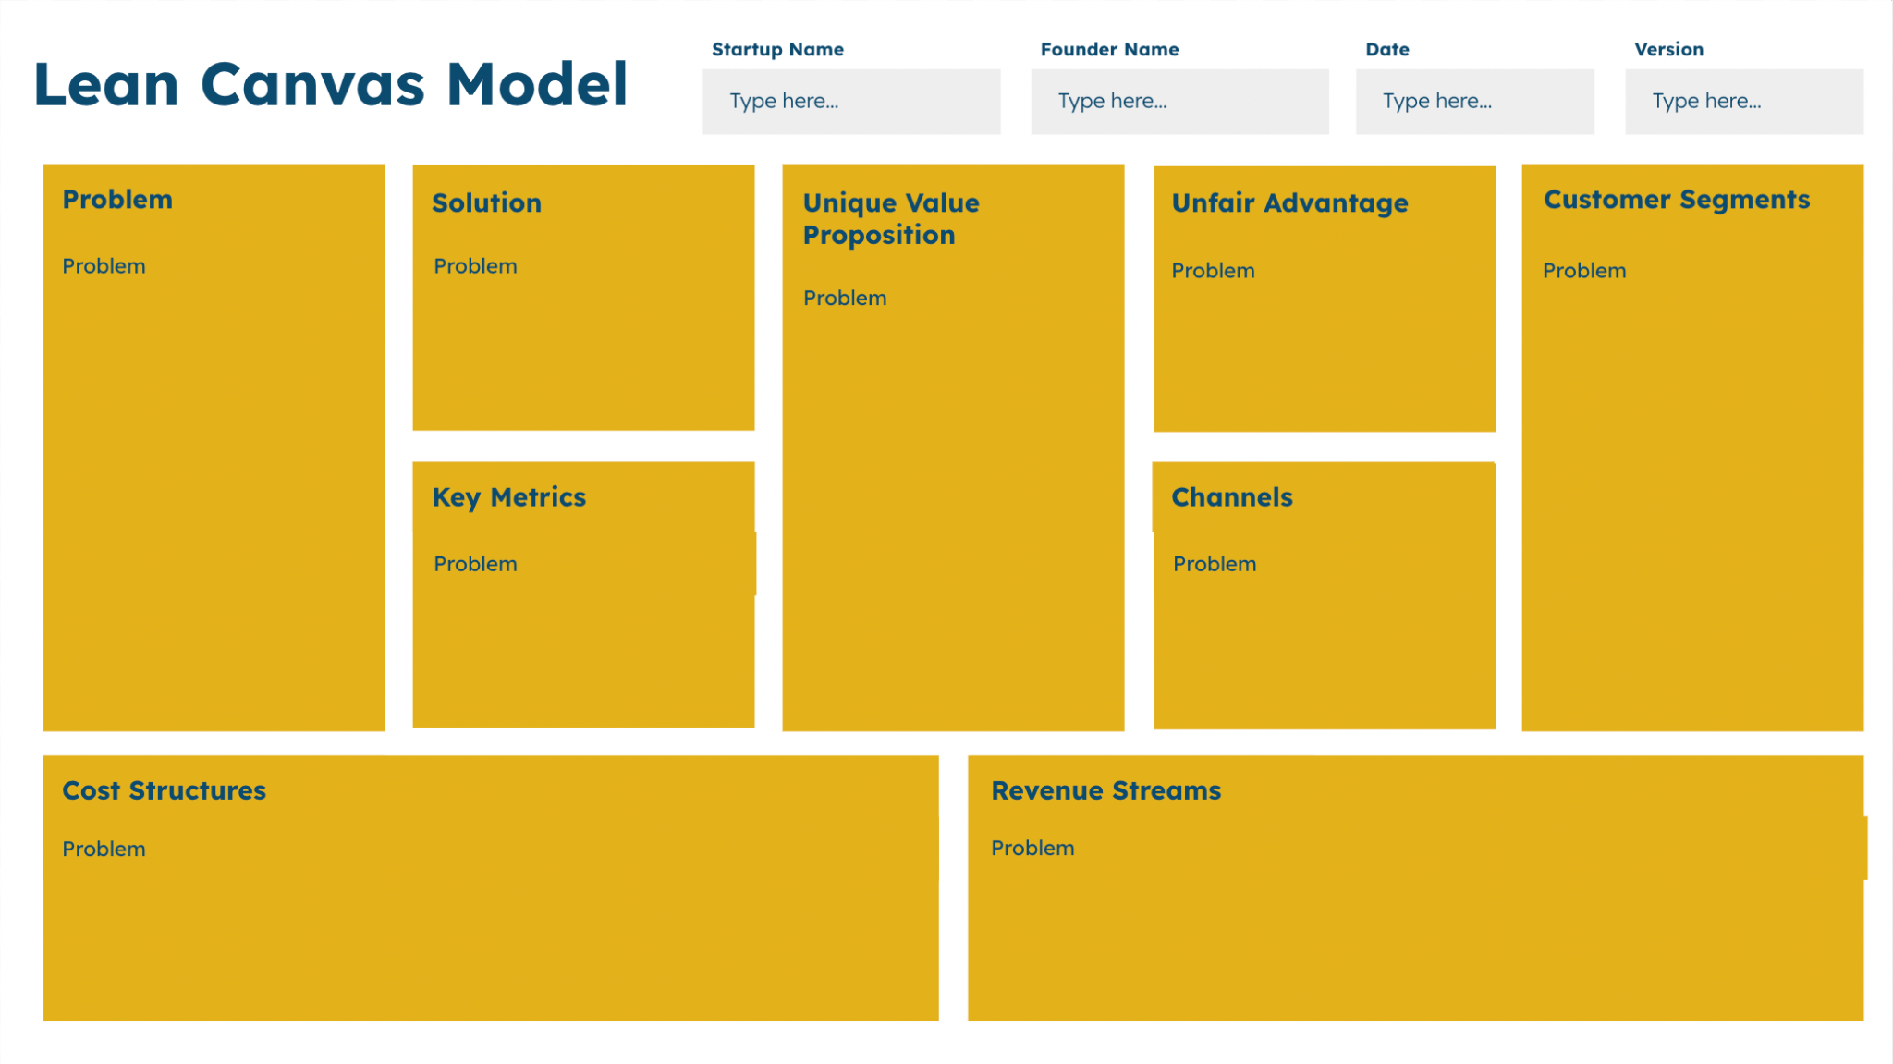
3 Versions
In this Founder Academy Guide, we’ve included three versions of the same Lean Canvas Model to help you get started.
Guide
Template
Example
Provides a summary of what each section means and should include.
This is the version that you will use to fill and submit as a deliverable.
Provides a real-world example of how the tool can be filled by an entrepreneur.

Slide 4
Guide
Startup Name
Founder Name
Date
Version
Lean Canvas Model
Type here…
Type here…
Type here…
Type here…
Problem
Solution
Unique Value Proposition
Unfair Advantage
Customer Segments
Describe the main pain point or challenge that the target customers are facing.
Outline the features, functions and technologies that that will solve the identified problem.
Articulate the key benefits and advantages of that the proposed solution offers to the target customers. How is it different from other solutions that are available?
Describe the unique strengths that your solution has over competitors, such as intellectual property, expertise or strategic partnerships.
Define the specific groups of customers that the solution will target, based on their characteristics, location, needs and behaviors.
Key Metrics
Channels
Identity the most important indicators that will be used to tackle the progress and success of your solution, such as customer acquisition, retention or revenue growth.
Identify the key ways that you will use to reach and engage your target customers, such as advertising, partnerships or social media.
Cost Structures
Revenue Streams
Outline the main expenses and investments required to develop, launch and operate the proposed solution, such as product development, marketing and staffing.
Describe the ways in which the proposed solution will generate revenue, such as subscription fees, commission on sales, or advertising revenue.

Slide 5
Template
Startup Name
Founder Name
Date
Version
Lean Canvas Model
Type here…
Type here…
Type here…
Type here…
Problem
Solution
Unique Value Proposition
Unfair Advantage
Customer Segments
Type here…
Type here…
Type here…
Type here…
Type here…
Key Metrics
Channels
Type here…
Type here…
Cost Structures
Revenue Streams
Type here…
Type here…

Slide 6
Example
Startup Name
Founder Name
Date
Version
Lean Canvas Model
Nairide App
Samuel F.
23 Feb 2023
V1
Problem
Solution
Unique Value Proposition
Unfair Advantage
Customer Segments
Lack of access to affordable and reliable transportation options in urban areas, leading to frustration and inefficiency for commuters and small business owners.
A mobile app that connects drivers with passengers or businesses in need of transportation services. Flexible pricing options that make it more affordable for customers.
Our tech-enabled ride-sharing platform provides affordable and reliable transportation options for commuters and small business owners in urban areas, with flexible pricing options and a convenient mobile app.
Strong relationships with local taxi associations
In-depth knowledge of the local market and culture
Commuters in urban areas: People who need to travel within the city for work, school, or leisure. They are looking for reliable, affordable, and convenient transportation options.
Small business owners who need to transport goods within the city: Entrepreneurs who need to move goods within the city to run their businesses. They are looking for affordable and efficient transportation options.
Key Metrics
Channels
Number of active users
Average ride cost and length
Customer retention rate
Social media advertising
Customer referral program
Taxi association partnership
Cost Structures
Revenue Streams
Development and maintenance of mobile app
Marketing and advertising expenses: We will allocate funds for marketing and advertising expenses, including social media ads, referral rewards, and partnership fees.
Staff salaries and benefits: We will hire a team of skilled professionals to manage our operations, customer service, and marketing activities.
Commission on ride fares: We will earn a commission on each ride fare paid through our platform, with rates that vary depending on the type of ride and the driver's performance.
Advertising partnerships with relevant brands: We will explore partnerships with relevant brands that want to reach our target customers, such as mobile phone companies or financial institutions.

